Slide 1
Permutation Hypothesis Tests
Robert Williams
Summer Statistics Workshop
6/18/2020

Slide 2
Permutation Hypothesis Tests
General concept
Determine statistical significance of test statistic between two groups (i.e. the mean value of treatment vs control)
Calculate all possible values of the test statistic under all possible rearrangements of the observed data points
When to use?
When you have small sample sizes
Test something other than classic approaches comparing means and medians
Assumptions of other approaches are not met
Adapted from MarinStatsLectures YouTube lesson

Slide 3
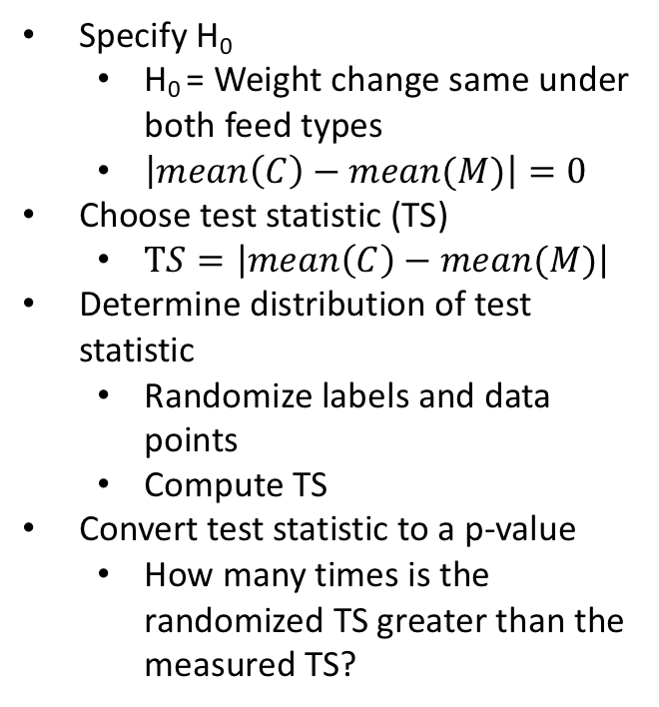
Is there a difference in chick weight between casein and meat meal diets?
12 Casein Fed Chicks
Specify H₀
H₀ = Weight change same under both feed types
$\left|mean\left(C\right)−mean(M)\right|=0$
Choose test statistic (TS)
$TS=\left|mean\left(C\right)−mean(M)\right|$
Determine distribution of test statistic
Randomize labels and data points
Compute TS
Convert test statistic to a p-value
How many times is the randomized TS greater than the measured TS?
11 Meat meal Fed Chicks

Slide 4
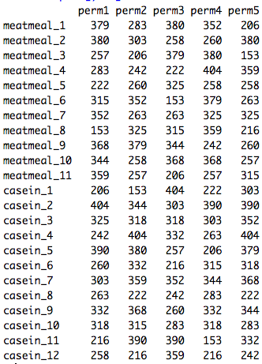
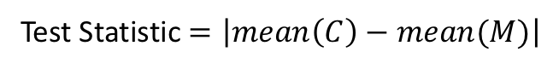
Perform Permutations
Sample | Observed Mean (g)
casein | 323.58
meatmeal | 276.90
… x 10,000
Test Statistic
Observed | 46.67
Test Statistic $=\left|mean\left(C\right)−mean(M)\right|$
 | Perm1 | Perm2 | Perm3 | Perm4 | perm5
Mean(M) | 310.18 | 284.36 | 292.09 | 325.81 | 272
Mean(C) | 293.0833 | 316.75 | 309.6 | 278.75 | 328.0833
Test Statistic | 17.09 | 32.3 | 17.5 | 47.06 | 56.08

Slide 5
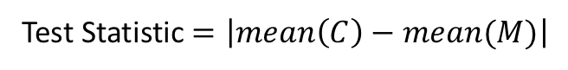
Calculate Test Statistic for each permutation
Calculate P-value
Observed, 46.6
p-value = # of times Permutation Test Stat > Observed Test Stat
Total number of Permutations
p-value = 0.099
Test Statistic $=\left|mean\left(C\right)−mean(M)\right|$

